Slide 1
Courses of river
DR. B.R.USARE
Assistant Professor
Department of Geography,
Government College of Arts and science,
Aurangabad.
WEL -COME

Slide 2
Courses of a river
Upper Course / Stage of Youth (Erosion dominates):
Middle Course/ Stage of Maturity (Transportation dominates):
Lower Course/ Stage of Old (Deposition dominates):
Upper Course / Stage of Youth (Erosion dominates):
It starts from the source of the river in hilly or mountainous areas.
The river flows down the steep slope and, as a result, its velocity and eroding power are at their maximum.
Streams are few, with poor integration.
As the river flows down with high velocity, vertical erosion or downward cutting will be high which results in the formation of
V-Shaped Valleys.
Waterfalls, rapids, and gorges exist where the local hard rock bodies are exposed.

Slide 3
Middle Course/ Stage of Maturity (Transportation dominates):
In this stage, vertical erosion slowly starts to replace with lateral erosion or erosion from both sides of the channel.
Thus, the river channel causes the gradual disappearance of its V-shaped valley (not completely).
Streams are plenty at this stage with good integration.
Wider flood plains start to visible in this course and the volume of water increases with the confluence of many tributaries.
The work of river predominantly becomes transportation of the eroded materials from the upper course (little deposition too).
Landforms like alluvial fans, piedmont alluvial plains, meanders etc. can be seen at this stage.

Slide 4
Lower Course/ Stage of Old (Deposition dominates):
The river starts to flow through a broad, level plain with heavy debris brought down from upper and middle courses.
Vertical erosion has almost stopped and lateral erosion still goes on.
The work of the river is mainly deposition, building up its bed and forming an extensive flood plain.
Landforms like braided channels, floodplains, levees, meanders, oxbow lakes, deltas etc. can be seen at this stage.

Slide 5
Erosion Types
Corrosion or Abrasion: As the rock particles bounce, scrape and drag along the bottom and sides of the river, they break off additional rock fragments. This form of erosion is called corrosion or abrasion. They are two types: vertical corrosion which acts downward and lateral corrosion which acts on both sides.
2.Corrosion or Solution: This is the chemical or solvent action of water on soluble or partly soluble rocks with which the river water comes in contact.
3.Hydraulic Action: This is the mechanical loosening and sweeping away of material by the sheer force or river water itself. No load or material is involved in this process.

Slide 6
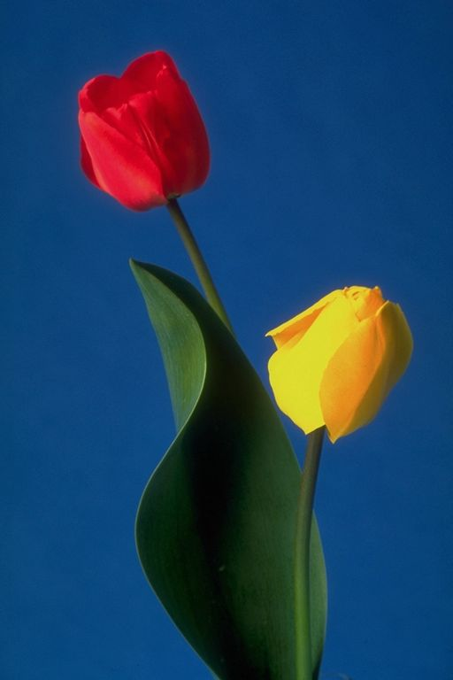
Thank You .....

